Slide 1
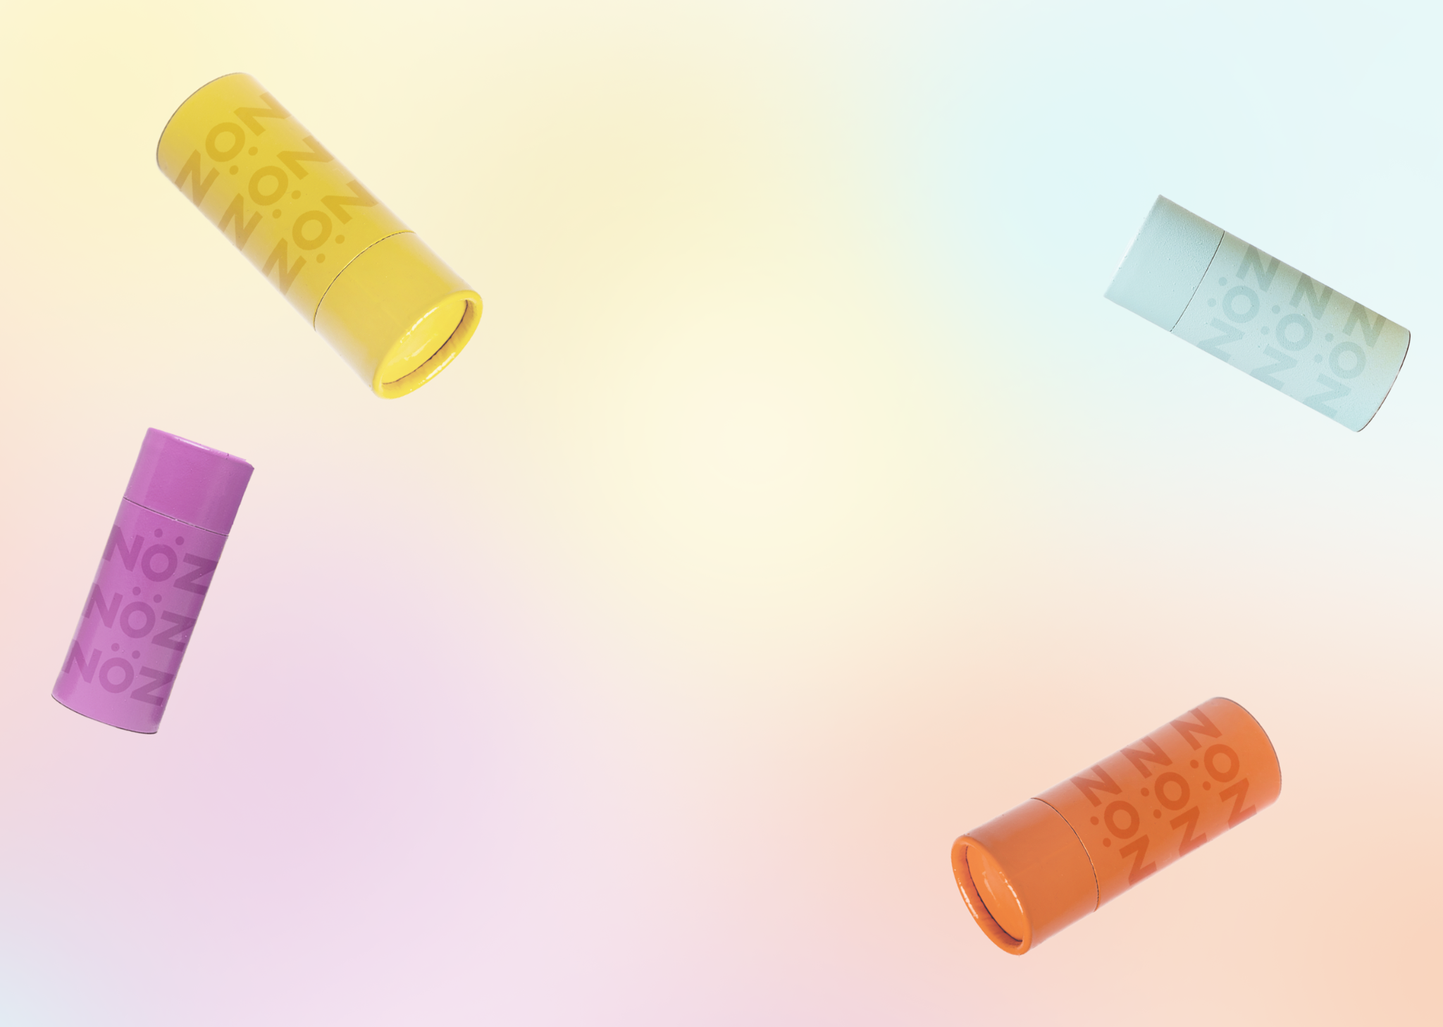
Nöz
Shopify Website
https://globaltech-paula-espinoza.myshopify.com/
Paula Espinoza
February 27th, 2023

Slide 2
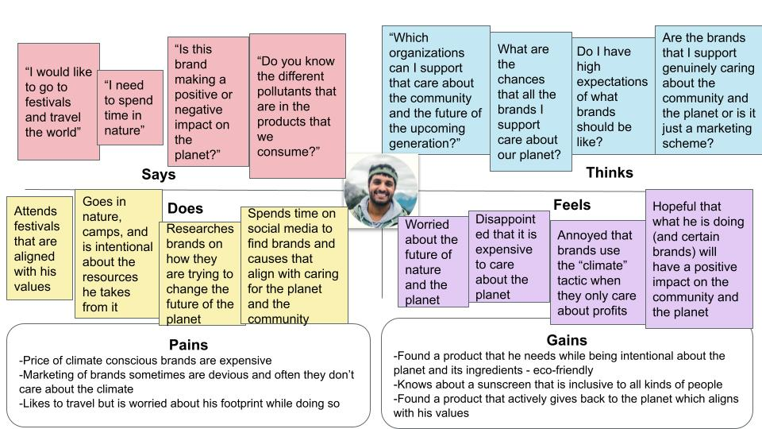
Target Customer
“Cory The Camper” is the customer persona targeted. People who enjoy traveling the world while being conscious of their footprint. They value companies that contribute to curb climate change
Nöz can help this person by providing an affordable sunscreen that does not disturb the climate by being cruelty free and reef-safe

Slide 3
Value Proposition
Daring and clean-conscious sunscreen that protects your skin and planet

Slide 4
Value Proposition
In the homepage, by thinking about my customer persona, my intention was to reflect the benefits of using our product that values our environment. My intention was also to align with the values that my customer identifies with by making sure they know we are also fun and adventurous like them.

Slide 5
Brand Visuals - Color Palette
I chose the color green because it is meant to reflect that our brand cares about Earth, and the yellow that is seen throughout the site is intended to reflect the feelings of our brand being playful, forward thinking, and optimistic.

Slide 6
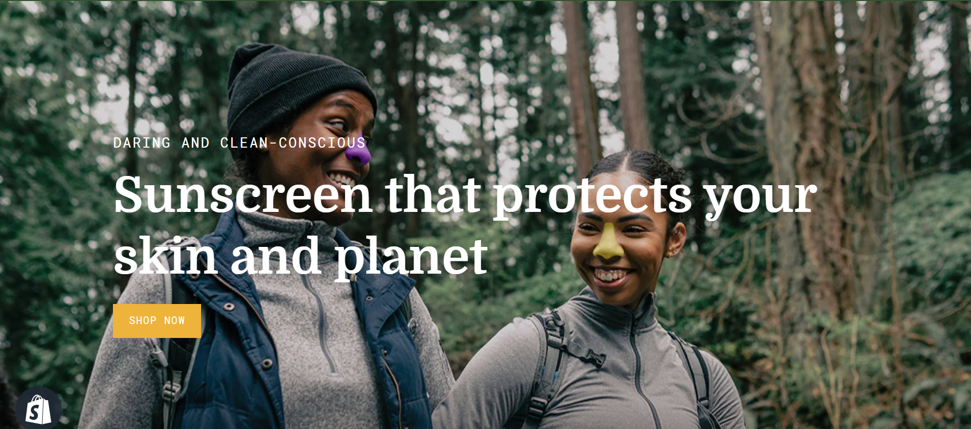
Brand Visuals - Photography
The chosen image aligns with the brand attributes of fun and adventurous, by having two individuals smiling in a genuine way outdoors. The photo style is candid and not posed.

Slide 7
SEO - Keyword research
[Using your keyword list from your screenshot to the right, select 5 of these keywords that you would use in your Meta Title and write them below:]
Reef-safe
Zinc-oxide sunscreen
Best spf for face
Coral-reef safe
Sunscreen for sensitive skin
These words were chosen because of their trend going up and their volume is higher than the rest. These words also align with the values of my targeted customer persona.

Slide 8
SEO - Site Meta Tags
Meta titles are important because they let a customer know what the site is about in the search engine results page. An effective Meta Title will incite customers to click a website if they know what the brand is about
Meta tags:
Zinc oxide sunscreen
Safe coral reef

Slide 9
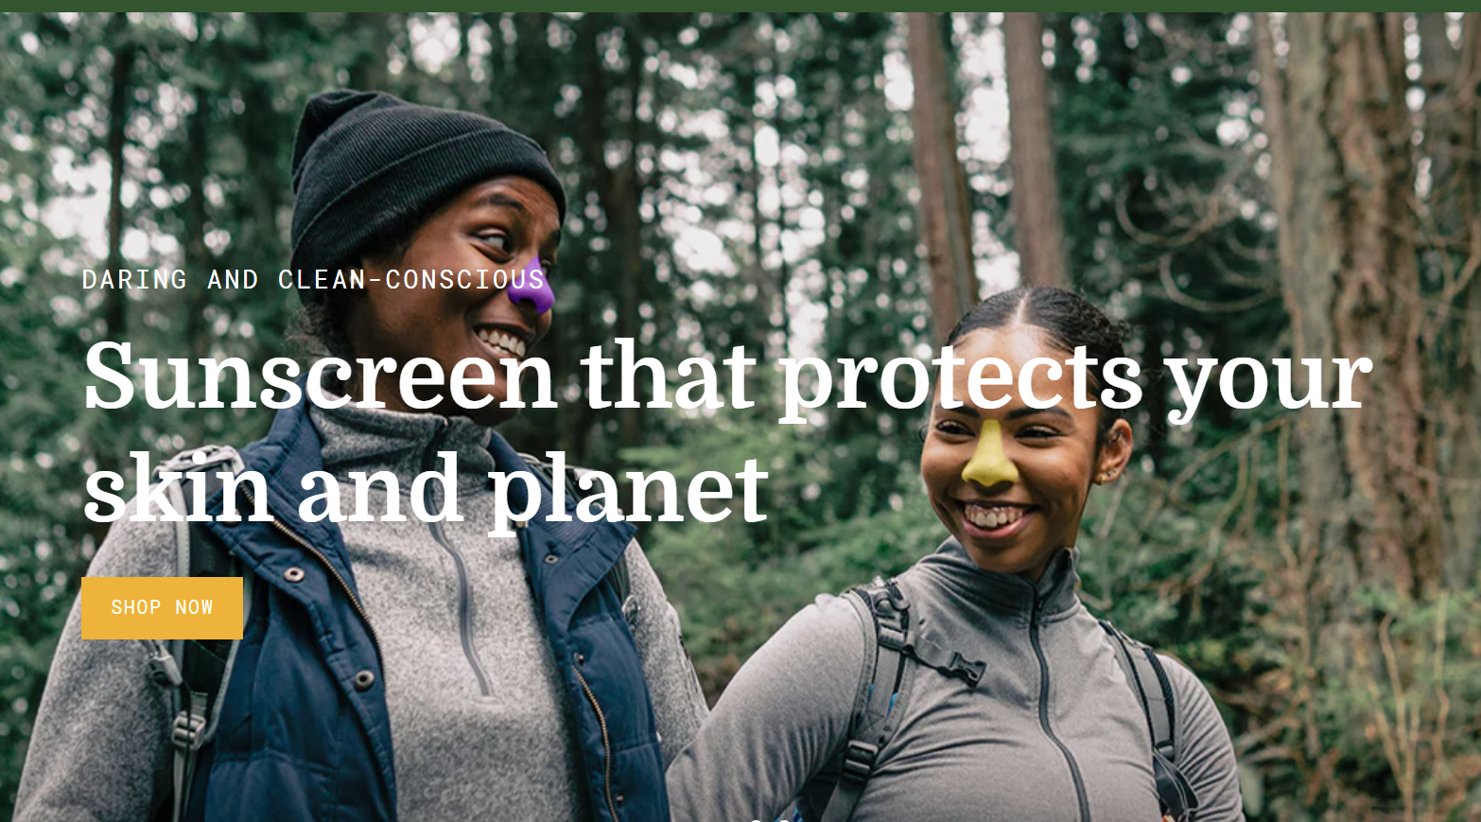
Landing Page Optimization
The CRO strategies implemented were as follows:
Hero image position is top left so the yellow nose can work as a directional cue.
Color of the CTA button is contrasted by the color yellow of the hero image.
Trust badges are shown in a color that brings the attention of the customer

Slide 10
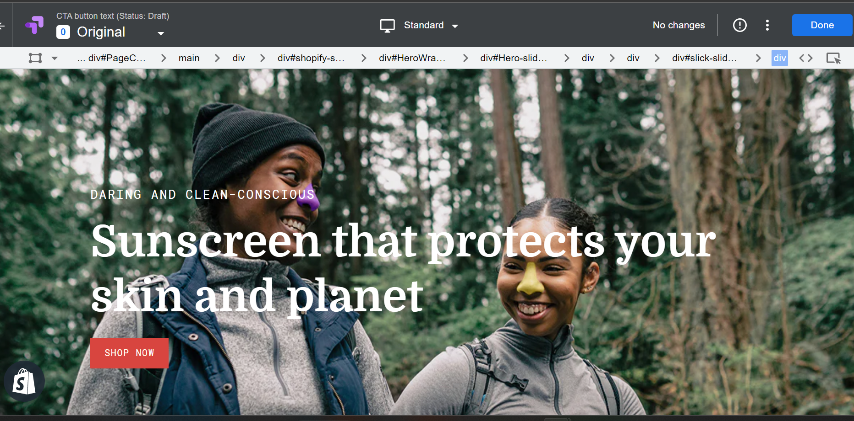
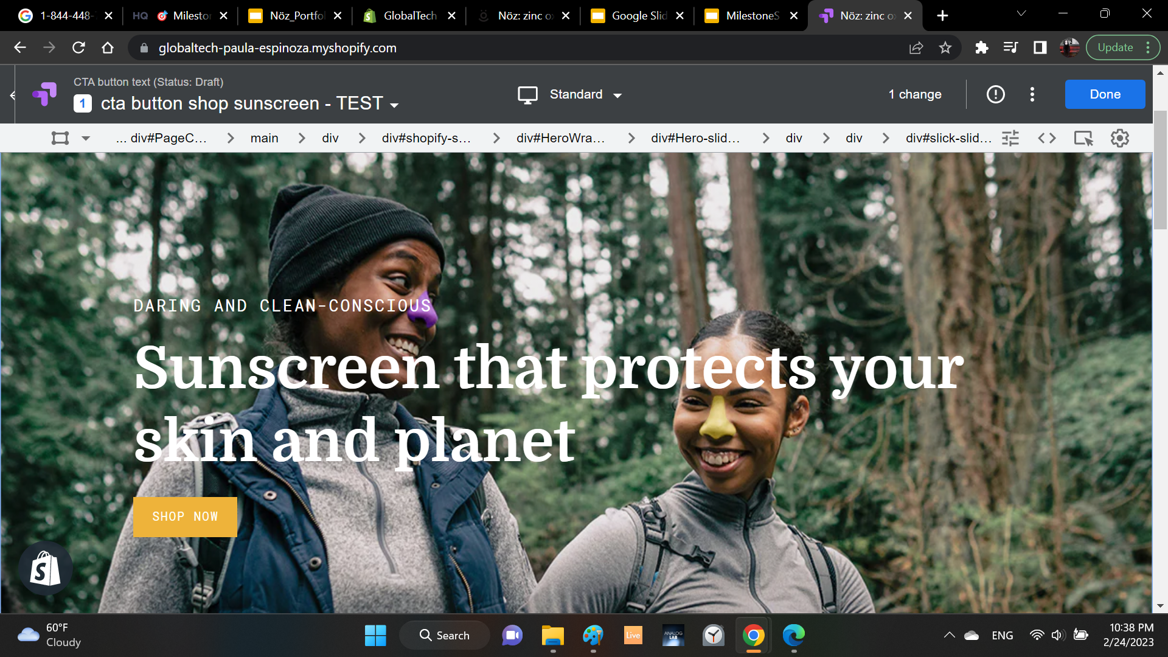
A/B Testing
Changing the CTA button will help convert traffic into customers

Slide 11
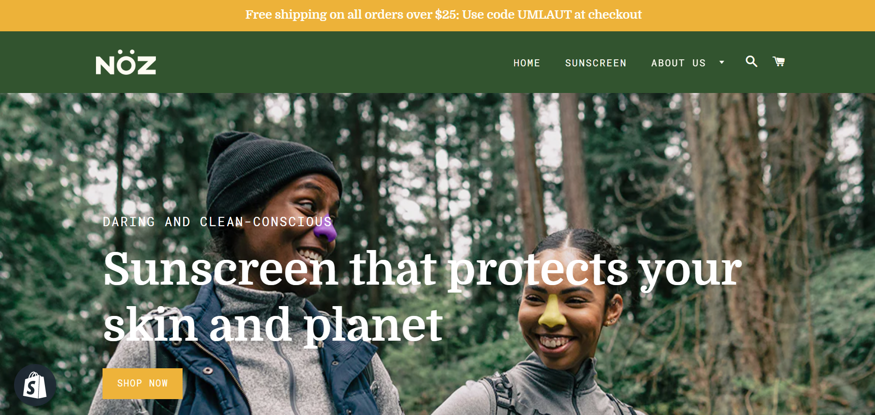
Promos & Offers

